Slide 1
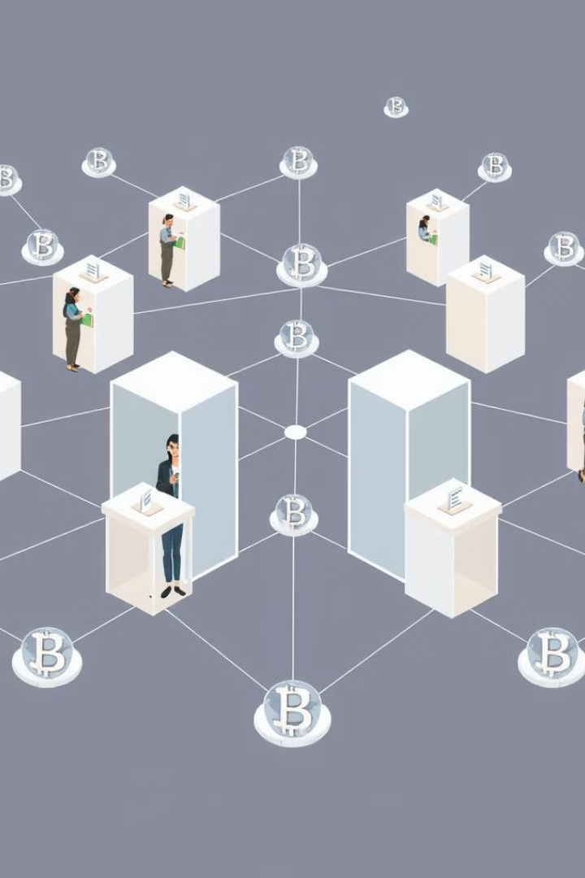
Decentralized Voting Application
This project demonstrates the development of a Decentralized Voting Application using Solidity for smart contract development and ReactJS for the front-end interface, harnessing the power of blockchain technology via the Ethereum network.

Slide 2

Introduction to Decentralized Voting
1
Transparent Voting
2
Secure Identity Verification
The decentralized nature of the application ensures that all votes are recorded on the blockchain, creating a transparent and immutable audit trail.
Cryptographic techniques are used to verify voter identities and prevent fraudulent voting, ensuring the integrity of the electoral process.
3
Decentralized Governance
The voting process is governed by smart contracts, eliminating the need for centralized authorities and reducing the risk of manipulation.

Slide 3
Technology Stack
Smart Contract Development:
Solidity: Language for writing smart contracts on Ethereum.
Frontend Development:
ReactJS: Library for building user interfaces.
Blockchain Network:
Ethereum: Decentralized platform for executing smart contracts.
Other Tools:
Truffle Suite: Development environment for Ethereum.
MetaMask: Ethereum wallet for managing identities and transactions.

Slide 4
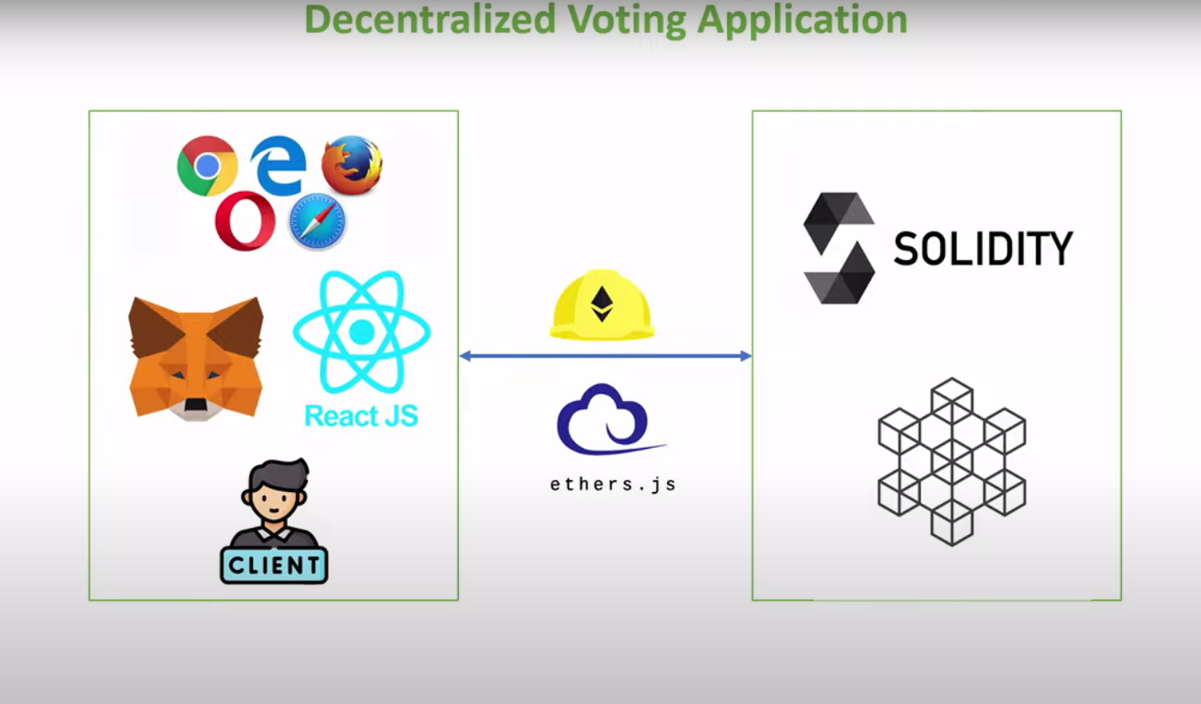

Slide 5
Problem Statement
Current Challenges in Voting:
Lack of transparency and trust in traditional voting systems.
Risks of fraud and manipulation.
Need for a secure, tamper-proof solution.

Slide 6
How the Decentralized Voting App Works
Connect Wallet & Register
Voters link their Ethereum wallet to the app for identity verification.
Each wallet is verified to ensure only eligible voters participate.
Select a Candidate
Voters choose their preferred candidate or option from the list displayed in the app.
The vote is prepared as a transaction for the blockchain.
Cast Vote via Blockchain
Voters cast their vote by confirming the transaction through their wallet.
The vote is recorded on the Ethereum blockchain, making it permanent and tamper-proof.
Automatic Vote Tallying
The smart contract automatically counts all votes as they are submitted.
No manual intervention is needed—results are calculated in real-time.
Results Published
After the voting period ends, final results are published on the blockchain.
Results can be viewed in the app and verified publicly on the Ethereum network.

Slide 7
Technologies Used:
Solidity
Ethereum Blockchain
ReactJS
The smart contract language used to define and implement the voting logic. All voting rules, candidate registration, and vote tallying are securely coded in Solidity, ensuring tamper-proof functionality on the blockchain.
Provides a decentralized network where the voting transactions are recorded. Every interaction, such as casting votes or retrieving results, happens on the Ethereum network, making the process transparent and secure
The user interface for the application is built with ReactJS, allowing voters to interact seamlessly with the smart contract on Ethereum. Through MetaMask integration, users can cast their votes while directly interacting with the blockchain from their browsers.

Slide 8
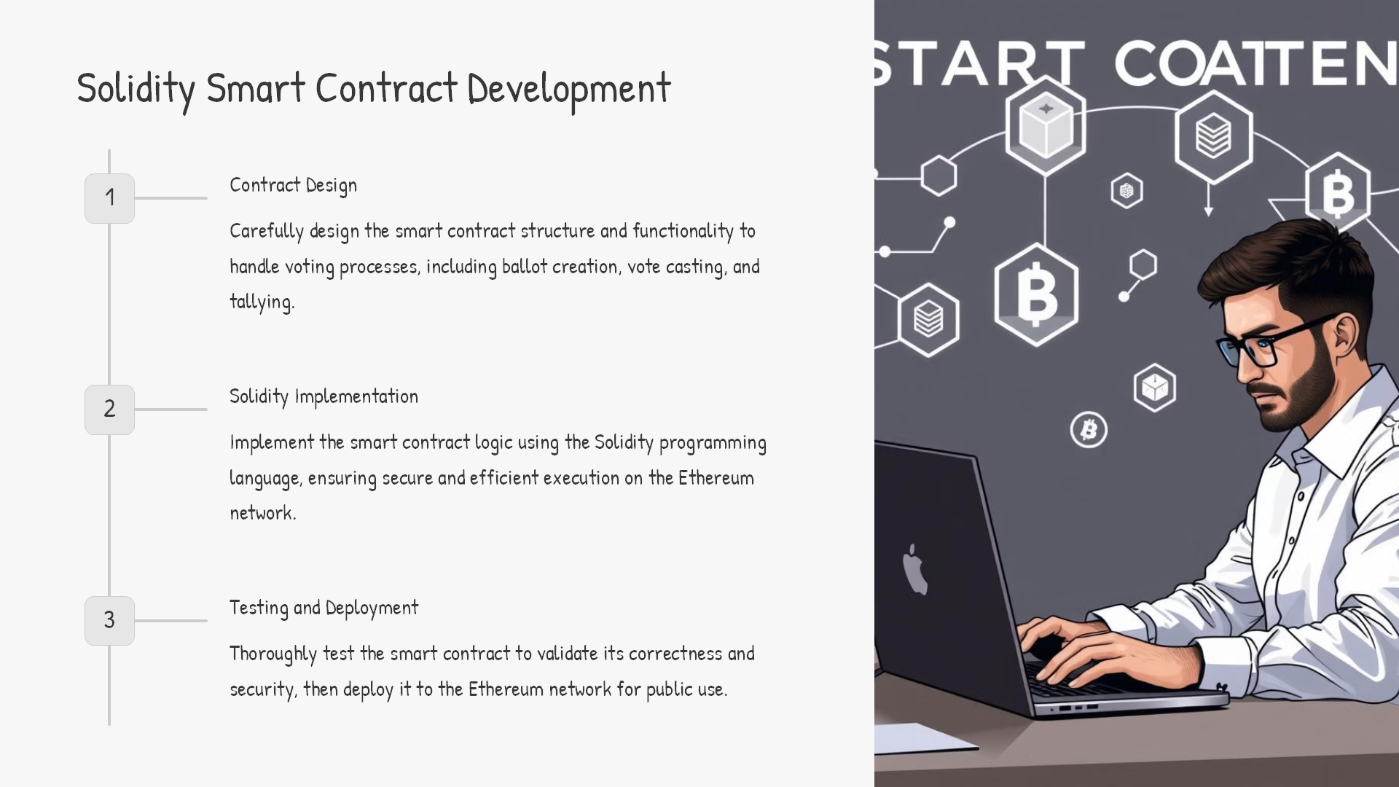

Slide 9
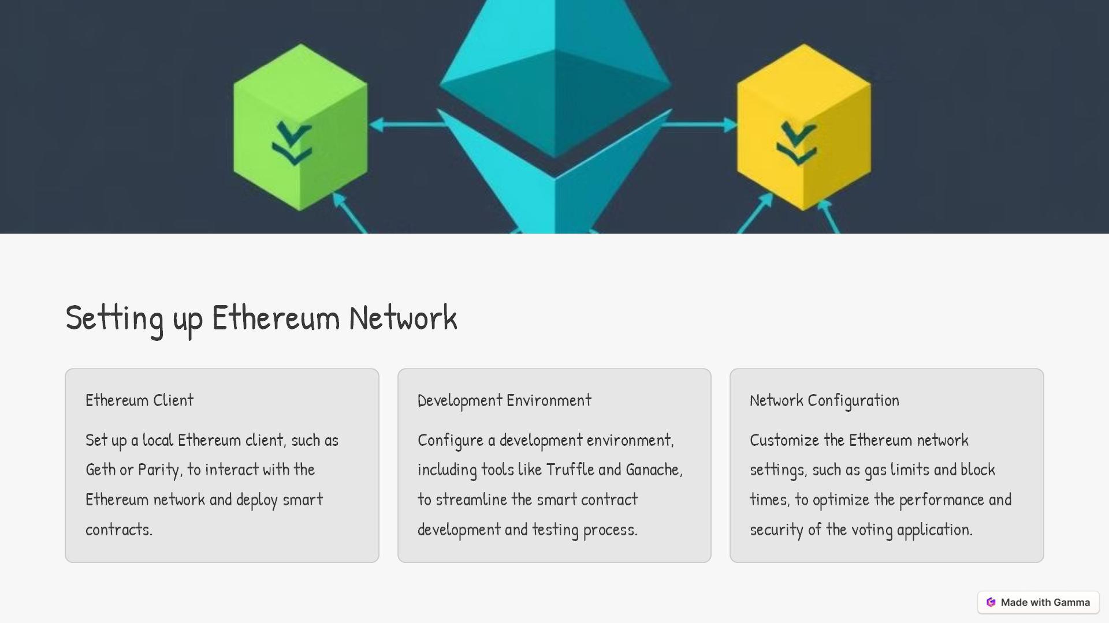

Slide 10

Deployment and Demo
Deployment
Package the decentralized voting application, including the smart contract and front-end, for seamless deployment on a cloud platform or a distributed network.
Demo
Showcase the full functionality of the decentralized voting application, highlighting its secure, transparent, and tamper-resistant features.

Slide 11
Key Benefits of Decentralized Voting Application
Transparency and Trust:
All votes are publicly recorded on the blockchain, providing a clear and transparent process.
Voters and third parties can verify election results independently, building trust in the system.
Immutable and Tamper-Proof:
Once recorded, votes cannot be altered or deleted, ensuring election integrity and preventing fraud.
The blockchain's immutability guarantees that the voting history remains unchanged.
Secure Identity Verification:
Cryptographic methods ensure that only legitimate voters can participate.
Each voter’s identity is tied to their Ethereum wallet, preventing identity fraud and vote duplication.
Decentralized Governance:
Smart contracts govern the voting process, eliminating the need for centralized authorities.
Voting rules and results are enforced automatically, reducing the risk of manipulation or human error.
Global Accessibility:
Voters can cast their votes from anywhere in the world, enabling wider participation, especially in global or large-scale elections.
Only a blockchain-connected device is required for participation, making the process highly inclusive.

Slide 12
